Slide 1
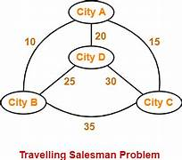


SPAM CLASSIFICATION
CAPSTONE PROJECT
CSA1363-THEORY OF COMPUTATION
PROJECT BY :
K.Kishore
192211912
D. Surendranadh
192211777
PROJECT GUIDE:
Dr.K. Vijaya Bhaskar

Slide 2

ABSTRACT
This capstone project aims to design and implement a machine learning model for spam classification.
The project will explore various algorithms, including Naive Bayes, Support Vector Machines, and Neural Networks, to determine the most effective approach.
A comprehensive dataset of labeled emails will be used to train and evaluate the models.
The primary goal is to achieve high accuracy and precision in distinguishing spam from legitimate emails, thereby enhancing email security and user experience.

Slide 3
INTRODUCTION
Spam classification is the process of identifying and filtering unsolicited and often irrelevant messages that are sent over the internet, usually to a large number of users, for the purposes of advertising, phishing, spreading malware, or other malicious activities.
This project focuses on developing a machine learning model to classify email messages as either spam or not spam (ham)
With the ever-increasing volume of email traffic, spam poses a significant challenge for both individuals and organizations.
Effective spam classification helps in reducing the clutter in inboxes, protecting users from malicious content, and saving time and resources.
This project is relevant due to the critical need for accurate and efficient spam detection mechanisms in the digital communication landscape.

Slide 4
CODING
#include <stdio.h>
#include <string.h>
#include <stdbool.h>
bool isSpam(const char *emailContent) {
// List of spam keywords
const char *spamKeywords[] = {
"winner", "free", "money", "prize", "click here", "urgent", "buy now",
"limited time offer", "cash", "guarantee", "loan", "risk-free", "unsubscribe"
};
size_t numKeywords = sizeof(spamKeywords) / sizeof(spamKeywords[0]);
for (size_t i = 0; i < numKeywords; ++i) {
if (strstr(emailContent, spamKeywords[i]) != NULL) {
return true;
}
}

Slide 5
/#include <stdio.h>
#include <string.h>
#include <stdbool.h>
bool isSpam(const char *emailContent) {
// List of spam keywords
const char *spamKeywords[] = {
"winner", "free", "money", "prize", "click here", "urgent", "buy now",
"limited time offer", "cash", "guarantee", "loan", "risk-free", "unsubscribe"
};
size_t numKeywords = sizeof(spamKeywords) / sizeof(spamKeywords[0]);

Slide 6
for (size_t i = 0; i < numKeywords; ++i) {
if (strstr(emailContent, spamKeywords[i]) != NULL) {
return true;
}
}
return false;
}
int main() {
char emailContent[1000];

Slide 7
printf("Enter the email content: ");
fgets(emailContent, sizeof(emailContent), stdin);
if (isSpam(emailContent)) {
printf("This email is classified as spam.\n");
} else {
printf("This email is not classified as spam.\n");
}
return 0;
}

Slide 8
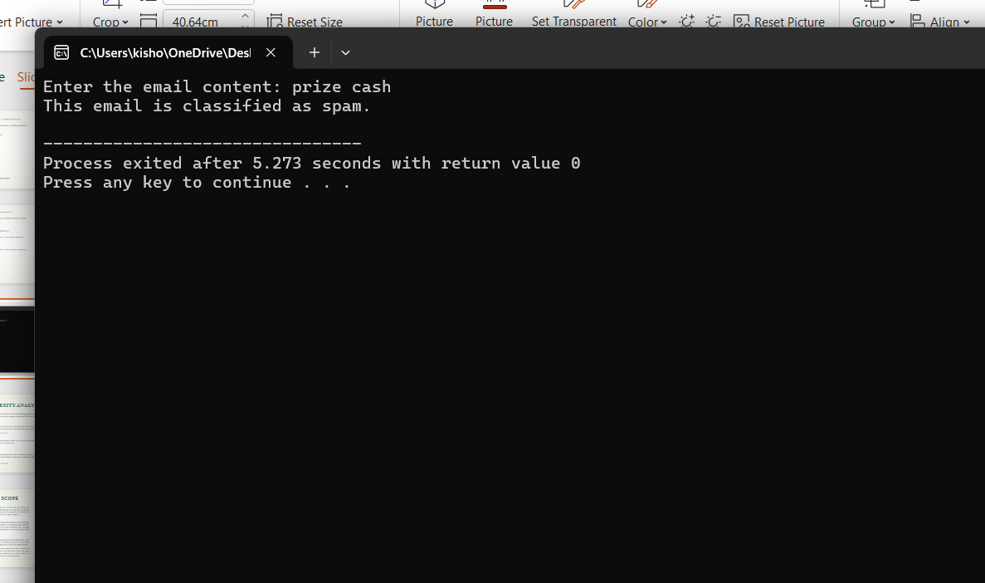

Slide 9
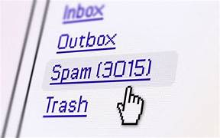
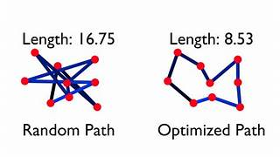

FUTURE SCOPE
Email service providers can integrate the model to improve their spam filters.
- Organizations can use the tool to safeguard their communication channels from spam.
- Individual users can utilize the application to filter out unwanted emails.
- Enhancing cybersecurity by identifying phishing and malware-laden emails.
Procedures and Methodology:
➢Automated Candidate Screening: Quickly analyze resumes to identify relevant ski ls, experience, and qualifications, saving time in the initial stages of recruitment.
➢Database Management: Populate and update candidate databases with parsed information, enabling efficient talent management and retrieval.
➢Customized Job Matching: Match candidate profiles with job requirements based on parsed data, facilitating more accurate and targeted candidate-job pai

Slide 10
CONCLUSION
Performance Metrics: Report accuracy, precision, recall, and F1-score for each model.
- Model Comparison: Compare the performance of different models and identify the most effective one.
- Real-World Testing: Test the selected model on a separate set of emails to assess its practical effectiveness.
- Insights: Provide insights into the strengths and weaknesses of the chosen approach and suggest future improvements.
This project successfully developed and evaluated multiple machine learning models for spam classification. The results demonstrate the potential of these models to effectively distinguish between spam and legitimate emails, contributing to enhanced email security and user experience.

Slide 11
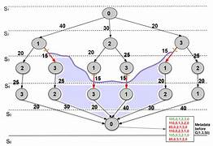


Thank you

